Slide 1
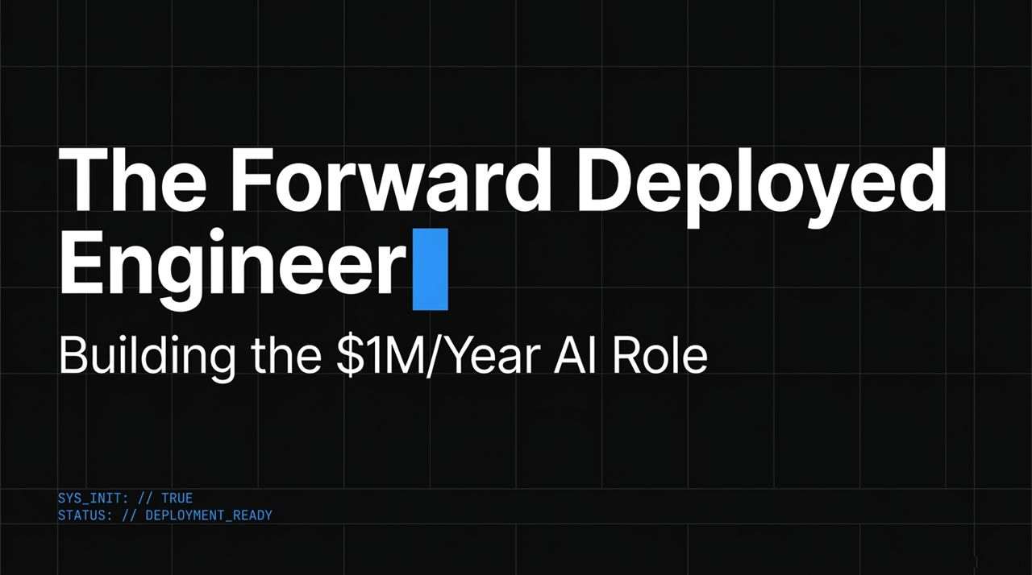
Notes:
Opening Hook: Welcome, everyone. Over the past few months, if you’ve been following AI trends on Twitter or tech forums, you’ve likely noticed a specific job title popping up everywhere: Forward Deployed Engineer, or FDE. What sounds like a niche term is rapidly becoming the single most lucrative and high-impact role in the modern AI ecosystem.
The Premise: We are witnessing compensation packages for elite Forward Deployed Engineers ranging anywhere from $150,000 base up to $1 million per year. Why? Because as AI models mature, companies are realizing that having access to raw intelligence is no longer enough to win.
Presentation Goals: Today, we are walking through the complete operational blueprint for what an FDE actually is, why top enterprises are paying top dollar for them, and how you can go from zero to mastering FDE execution within a structured 30-day framework.
https://www.youtube.com/watch?v=zXysLUTLjw4

Slide 2
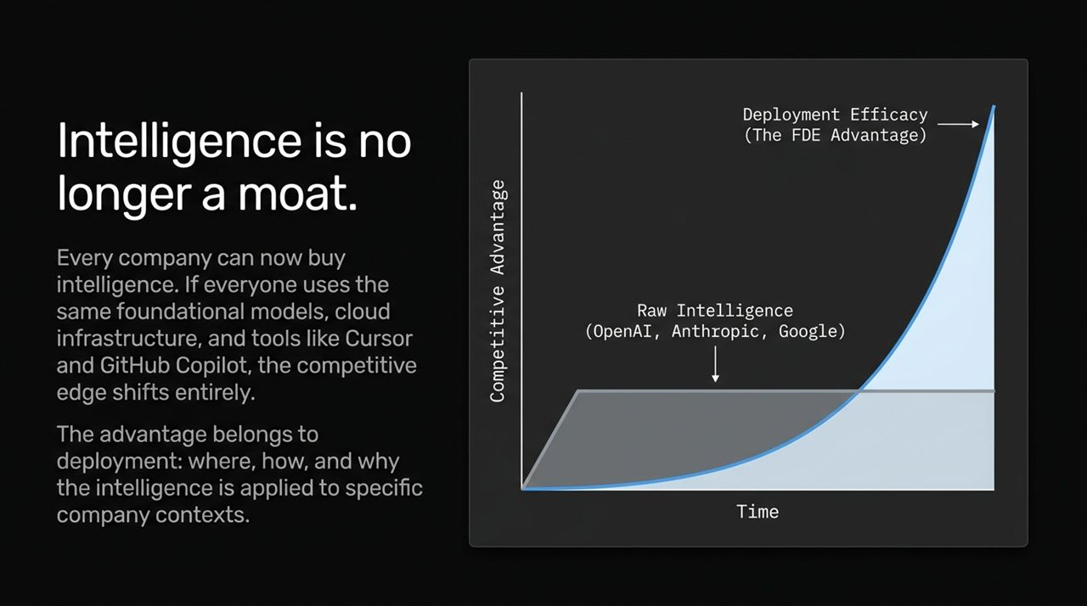
Notes:
The Core Shift: Let's look at the graph on this slide. A year or two ago, having access to a frontier LLM was considered a significant technical edge. Today, intelligence has become a standardized commodity.
Leveling the Playing Field: Whether you are a startup or a Fortune 500 firm, everyone can buy intelligence off the shelf. Enterprise engineering teams are using identical tooling—Cursor, GitHub Copilot, OpenAI, Anthropic, and Google Cloud infrastructure. When every player uses the same underlying intelligence stack, raw intelligence ceases to be your moat.
Where the Moat Moves: Look at the blue curve on the diagram labeled Deployment Efficacy (The FDE Advantage). As model performance plateaus across providers, competitive advantage shifts entirely to Deployment: where, how, and why that intelligence is integrated into specific company contexts. The real winner isn't who has the biggest model, but who builds the best bridge between general intelligence and custom business operations.

Slide 3
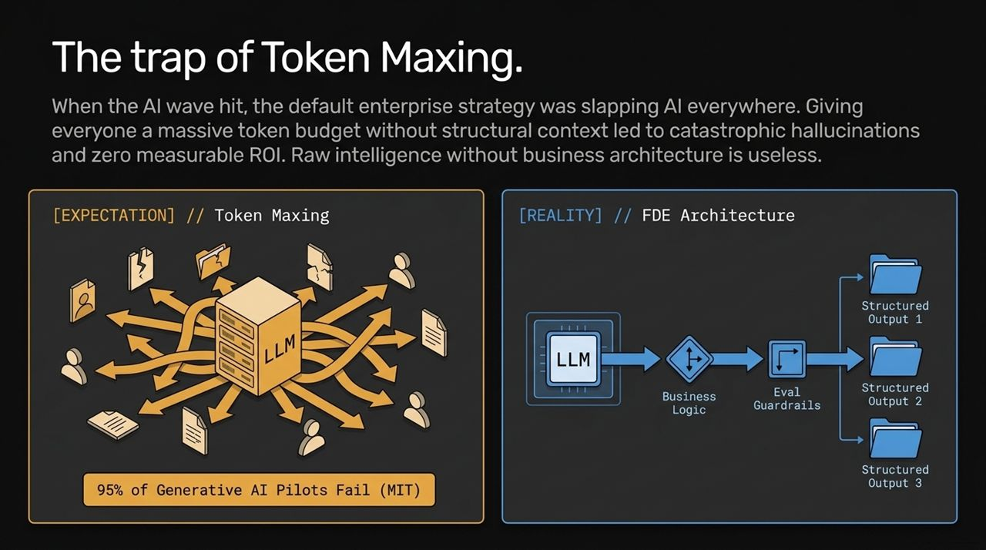
Notes:
The "Token Maxing" Mistake: When Generative AI first erupted, enterprise strategy defaulted to "Token Maxing"—slapping LLM API calls onto every existing business process without architectural thought.
Real-World Failures: Executives threw massive budgets at raw tokens, expecting the LLM to figure out messy enterprise operations on its own. The result? Widespread hallucinations, skyrocketing API bills, and catastrophic failure rates. An MIT study recently highlighted that 95% of Generative AI pilots fail to reach production. There are real cases of C-suite leaders burning through $10M cloud budgets in 3 months with zero measurable ROI.
The FDE Architecture Solution: Look at the right-hand diagram. Real production utility requires FDE Architecture. Instead of dumping raw data into an LLM and hoping for the best, an FDE builds a deterministic pipeline around the LLM: wrapping it with business logic routing, automated evaluation guardrails, and enforcing structured JSON outputs.

Slide 4
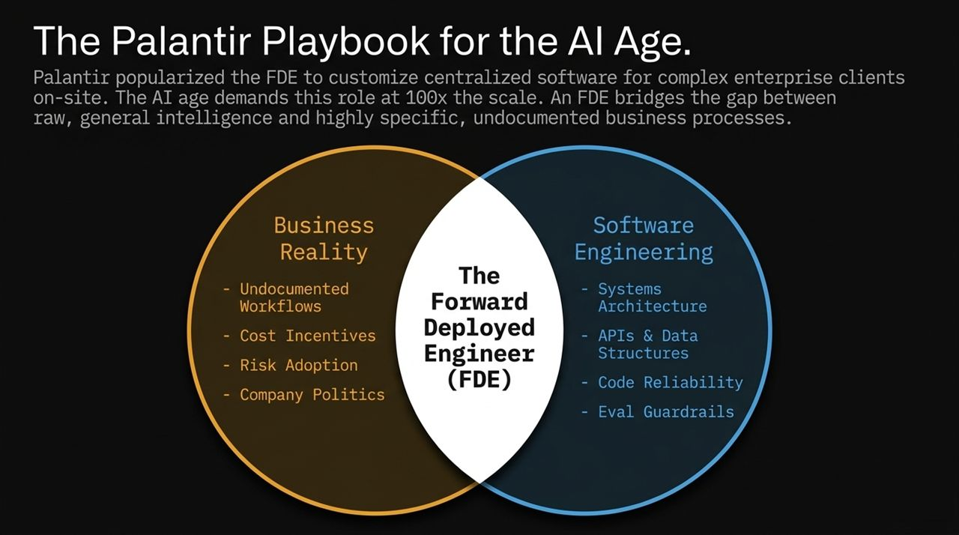
Notes:
Origin Story: The term Forward Deployed Engineer was originally pioneered and popularized by Palantir. Palantir sent technical teams on-site to government agencies and large corporations to embed deeply, understand complex datasets, and customize their software platform directly where the work happened.
Scaling 100x in the AI Era: While Palantir solved the data unification problem, the AI age requires this exact same playbook at 100x scale. Every company now needs custom AI agents tailored to their unique environments.
Bridging the Venn Diagram: As shown in the Venn diagram, an FDE stands at the exact intersection of Business Reality and Software Engineering:
Business Reality: Uncovering undocumented workflows, understanding cost structures, navigating corporate politics, and identifying actual risk tolerances.
Software Engineering: Systems architecture, API integration, code reliability, evaluation guardrails, and deterministic fallback mechanics.

Slide 5
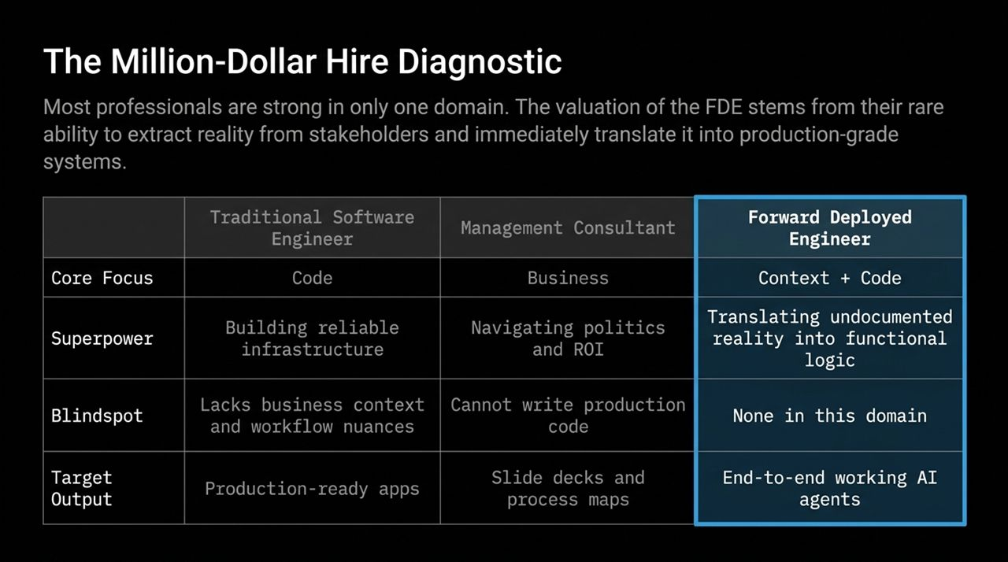
Notes:
Why the Role is So Rare: Why do companies pay up to $1M for an FDE? Because traditional roles fall into distinct, isolated domain traps.
Comparing the Profiles:
Traditional Software Engineers excel at code reliability and building infrastructure, but they often lack business context and ignore non-technical workflow nuances.
Management Consultants excel at navigating corporate politics and mapping high-level business goals, but their output stops at slide decks and process diagrams—they cannot write production code.
The FDE Superpower: The FDE merges the analytical power of a consultant with the execution power of a senior systems engineer. They sit down with business stakeholders, extract undocumented operational truths, and immediately convert that reality into functional, production-ready AI software agents.

Slide 6
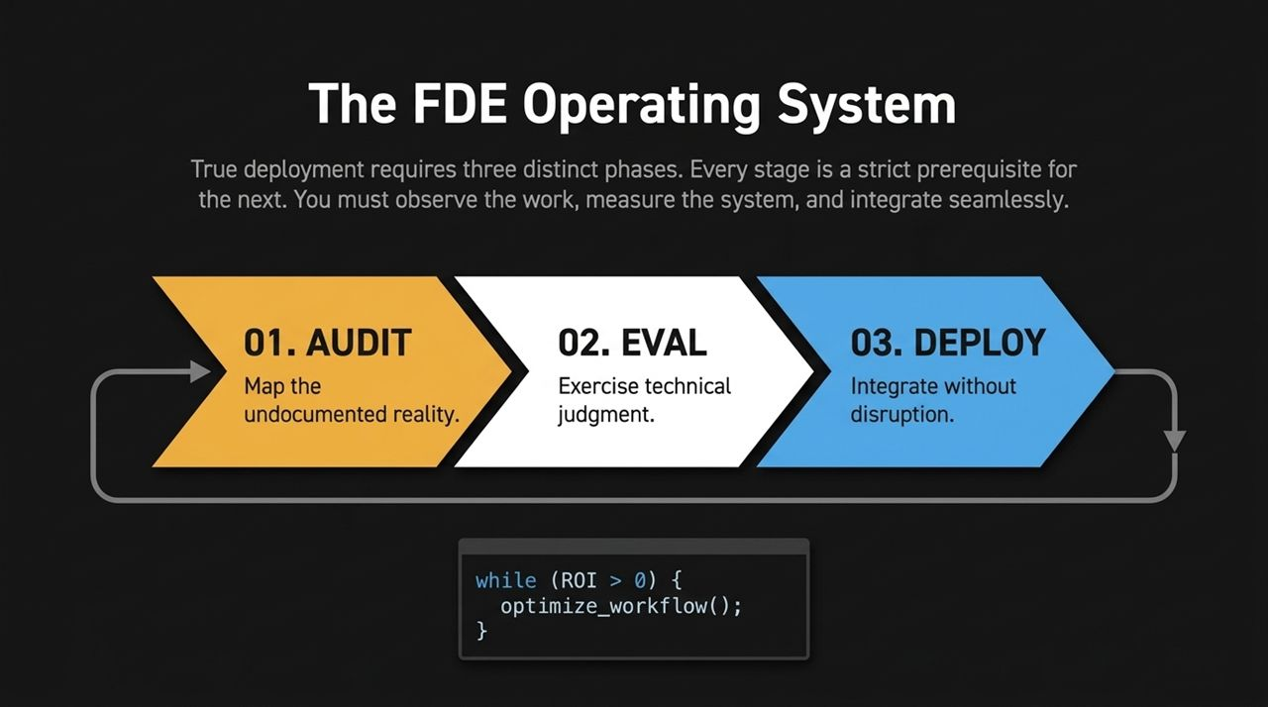
Notes:
Systematic Framework: Successful deployment isn't random trial-and-error; it follows a strict 3-phase Operating System where each phase is an absolute prerequisite for the next.
Phase 1: AUDIT: Before writing code, you must observe how work actually gets done on the ground. You extract undocumented realities and map out edge cases.
Phase 2: EVAL: Apply technical judgment to design evaluative criteria. Prove the system behaves safely and consistently before giving it autonomy.
Phase 3: DEPLOY: Seamlessly integrate the AI agent into legacy tech stacks without forcing disruptive software overhauls.
Continuous Optimization: The core execution loop runs as long as ROI remains positive (while (ROI > 0) { optimize_workflow(); }).

Slide 7
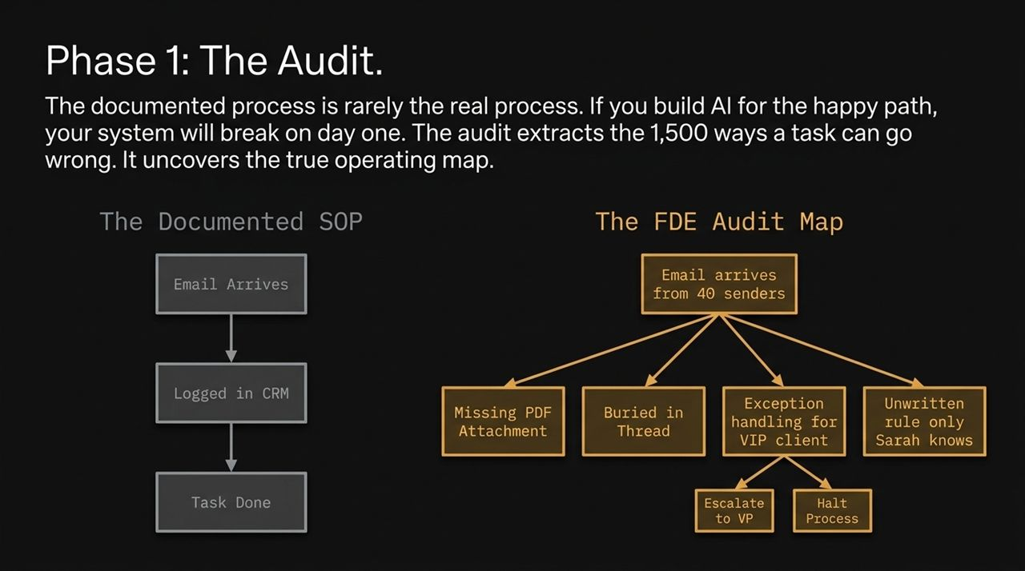
Notes:
Documented SOP vs. Real SOP: The biggest mistake junior engineers make is building AI based on official Standard Operating Procedures (SOPs). Official SOPs represent the "happy path"—e.g., "Email arrives -> Log in CRM -> Task done".
The 1,500 Unhappy Paths: In real business environments, tasks break in thousands of ways. Look at the FDE Audit Map:
Emails arrive from 40 different senders with inconsistent formatting.
PDF attachments are missing or text is buried in messy email threads.
Exception rules exist only in one key employee's head (e.g., "Sarah's unwritten VIP rule").
FDE Action: An FDE spends hours sitting side-by-side with operators to capture these hidden exceptions. If you build for the happy path, your deployment breaks on Day 1.

Slide 8
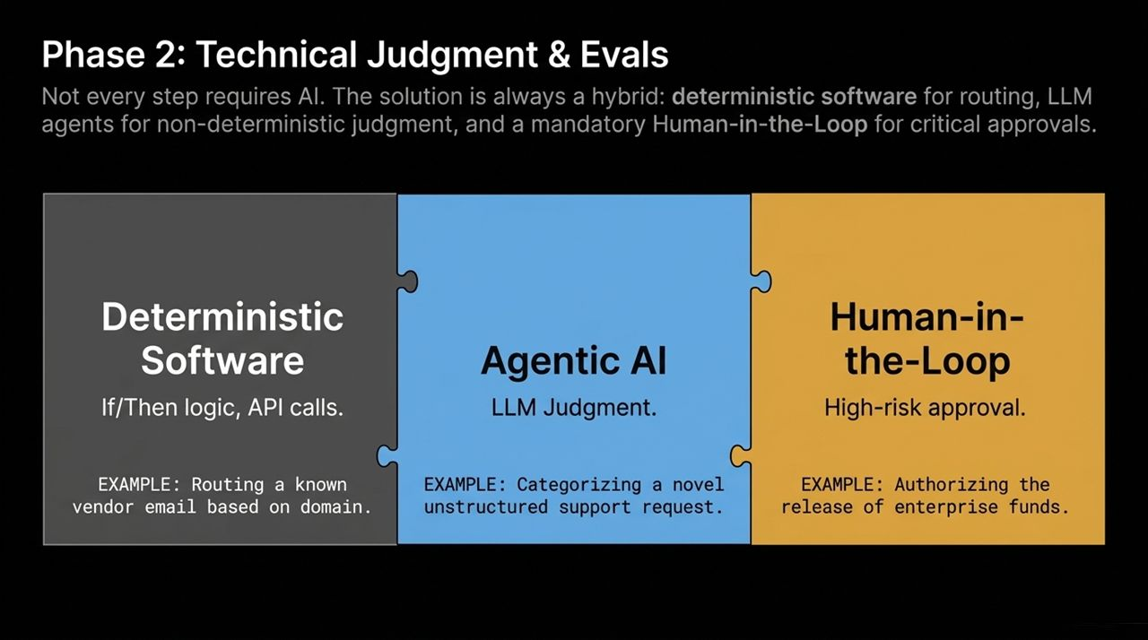
Notes:
Knowing Where NOT to Use AI: Elite FDEs know that throwing LLMs at every sub-task is inefficient and dangerous. A production architecture must balance three distinct layers:
Deterministic Software: Use traditional code (If/Then rules, rigid APIs) for predictable tasks like email routing by domain.
Agentic AI / LLM Judgment: Reserve non-deterministic LLMs specifically for tasks requiring human-like judgment, such as categorizing unstructured support requests.
Human-in-the-Loop (HITL): Mandate human sign-off for high-risk actions, such as releasing enterprise funds or signing contracts.
Evaluation Suites: Evals transform non-deterministic LLM behavior into quantifiable metric evidence, ensuring accuracy benchmarks are hit before rollout.

Slide 9
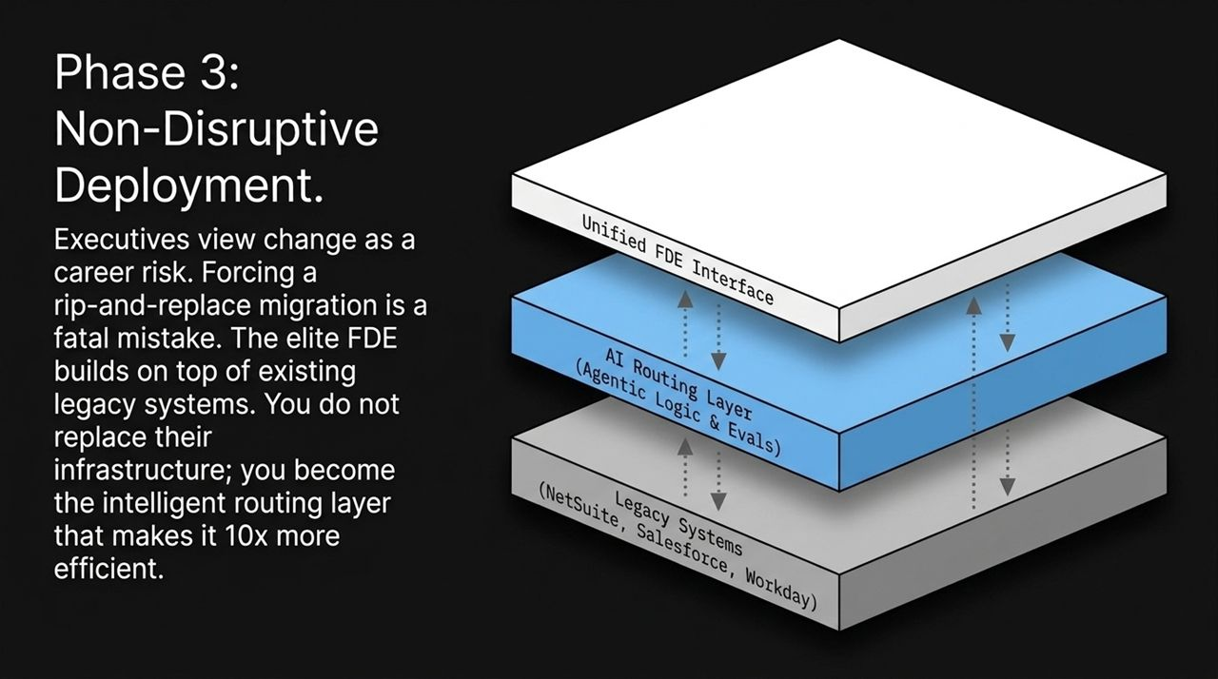
Notes:
De-Risking Enterprise Adoption: Enterprise executives are naturally risk-averse. Proposing that a client replace their entire ERP software (like NetSuite or SAP) with a new AI system is an immediate deal-breaker.
The Routing Layer Strategy: Instead of forcing migrations, an FDE builds an AI Routing Layer on top of existing legacy infrastructure.
Unified Interface: The FDE connects NetSuite, Salesforce, Workday, and internal databases through a unified routing system. The client keeps their core tools, while the FDE's agentic logic makes the overall workflow 10x faster.

Slide 10
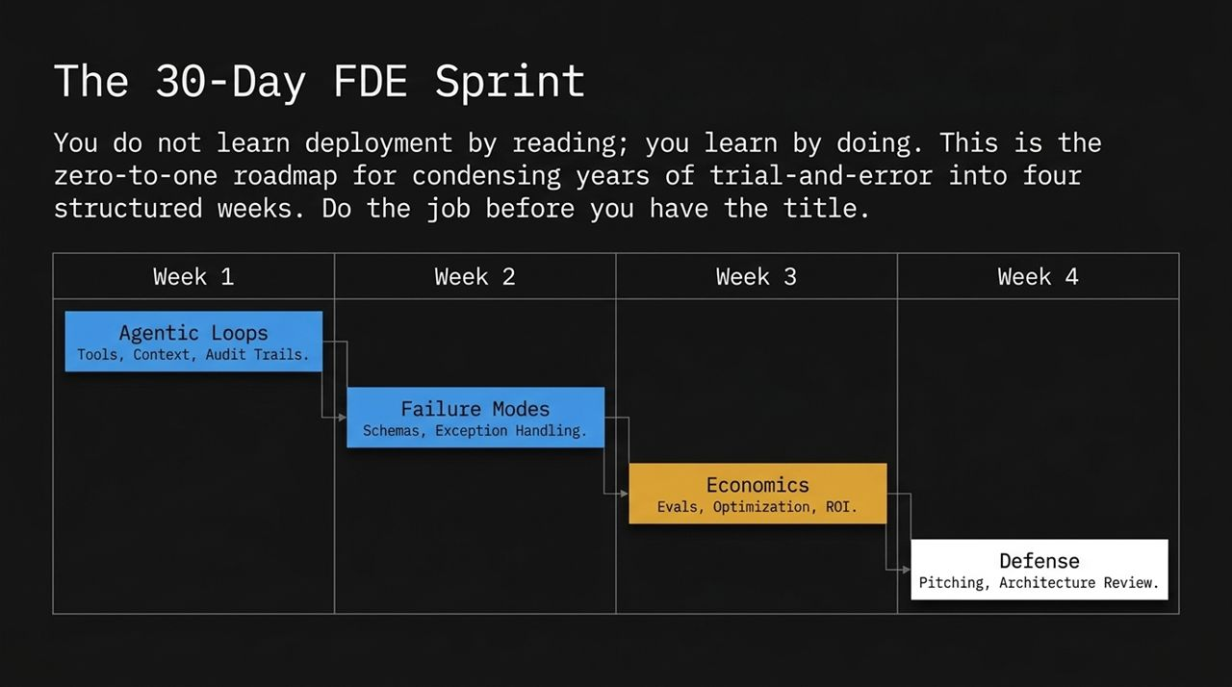
Notes:
Learning by Doing: You cannot become a Forward Deployed Engineer by reading textbooks or watching tutorials—you learn through practical execution. This slide presents a 4-week structured sprint to build FDE competency:
Week 1 (Agentic Loops): Master agent tools, context windows, memory structures, and comprehensive audit logs.
Week 2 (Failure Modes): Move beyond simple prompts. Engineer rigid JSON schemas, error handling, and automated fallbacks.
Week 3 (Economics): Build evaluation suites, calculate token usage costs, swap sub-tasks to smaller models, and calculate net ROI.
Week 4 (Defense): Rehearse system architecture defense as a lead engineer and pitch business metrics like a VP.

Slide 11
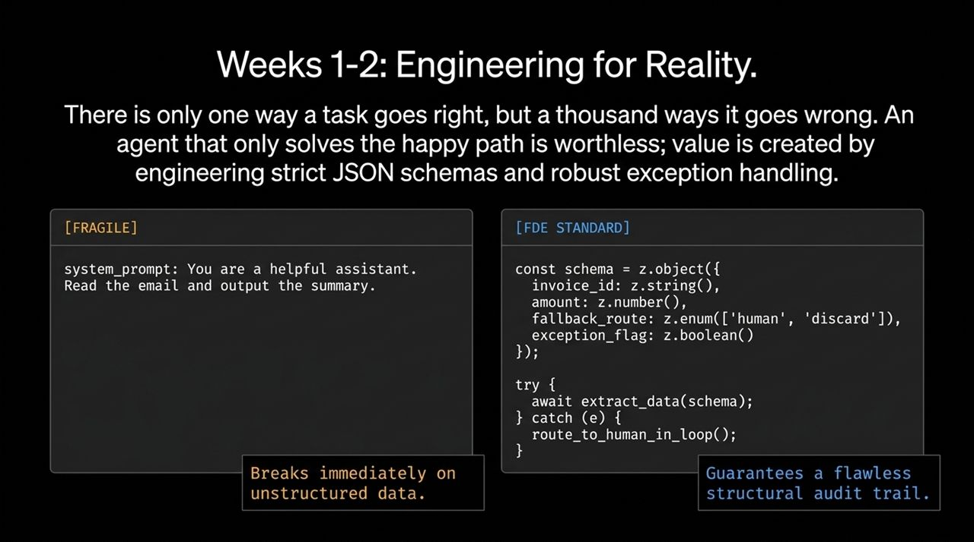
Notes:
Fragile vs. FDE Standard: Slide 11 contrasts weak prompt engineering with true FDE system design.
The Fragile Prompt: Writing a generic system prompt like "You are a helpful assistant. Read the email and output the summary" fails instantly in enterprise environments when encountering unstructured or corrupted data.
The FDE Standard: FDEs enforce strict typing using validation libraries (e.g., Zod schemas in TypeScript). Look at the code sample:
Outputs are forced into exact JSON formats (invoice_id, amount, exception_flag).
System exceptions are caught in code loops (try { ... } catch { route_to_human_in_loop(); }).
Value Creation: By engineering explicitly for exceptions and bad inputs, you build systems that maintain audit trails and never crash silently.

Slide 12
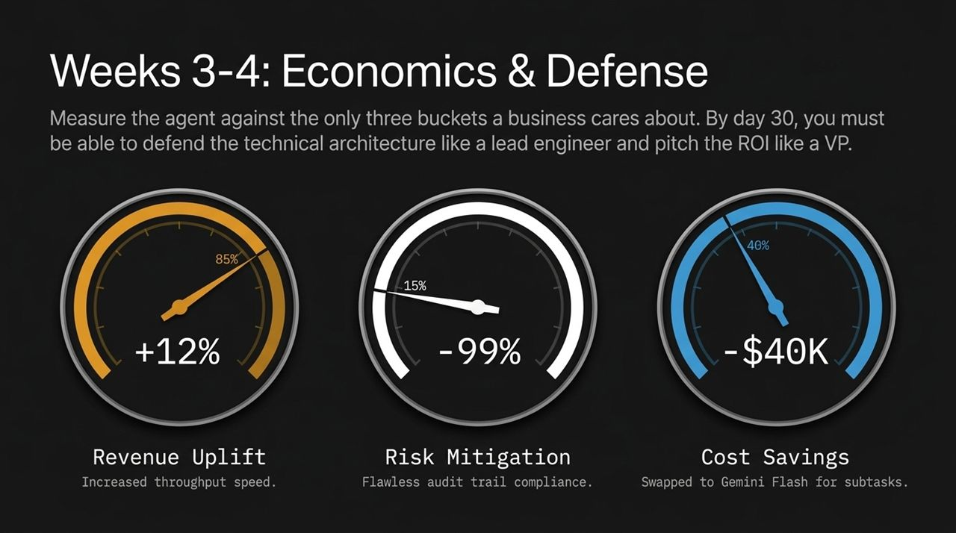
Notes:
Speaking the Language of Business: At the end of the sprint, technical success must translate into clear business outcomes. Business executives care about three main levers:
Revenue Uplift (+12%): Speeding up processing throughput allows businesses to take on more clients and generate more revenue faster.
Risk Mitigation (85% -> 99% / -99% Risk): Replacing manual, error-prone processes with verified automated audit trails reduces compliance risk.
Cost Savings (-$40K): Optimizing model choices (e.g., swapping expensive frontier models for faster, lower-cost options like Gemini Flash for basic sub-tasks) slashes operating costs.

Slide 13
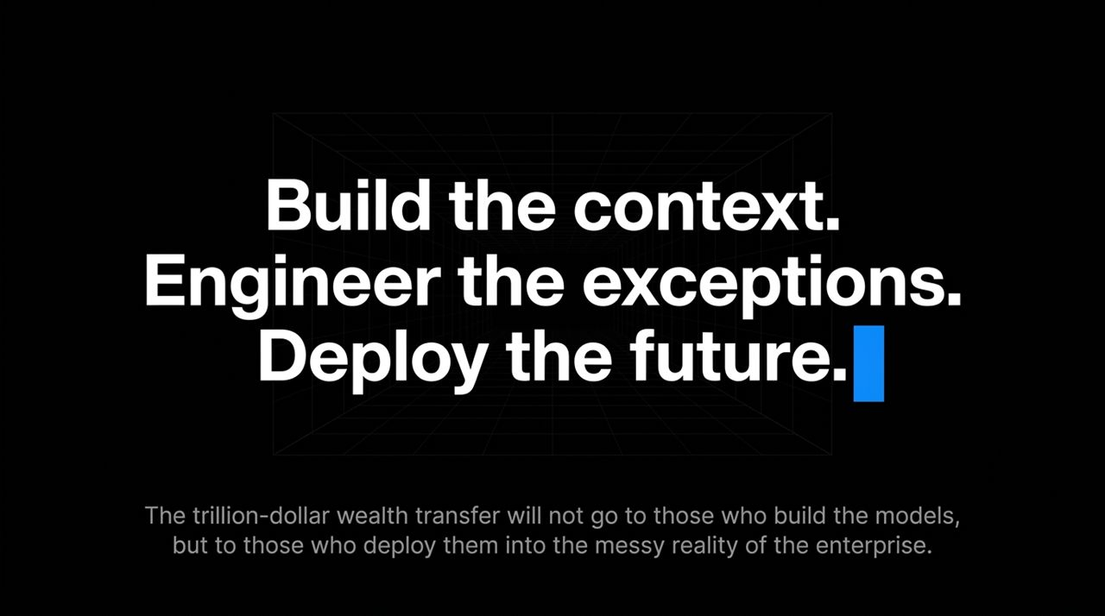
Notes:
The Trillion-Dollar Opportunity: As summarized on the slide: "The trillion-dollar wealth transfer will not go to those who build the models, but to those who deploy them into the messy reality of the enterprise."
Recap of Core Pillars:
Phase 1 (Audit): Investigating messy manual workflows and unwritten operational steps.
Phase 2 (Technical Judgment): Choosing where AI adds leverage versus where deterministic code or human review belongs.
Phase 3 (Deployment): Building resilient agentic pipelines that plug directly into existing enterprise tech stacks.

Slide 14
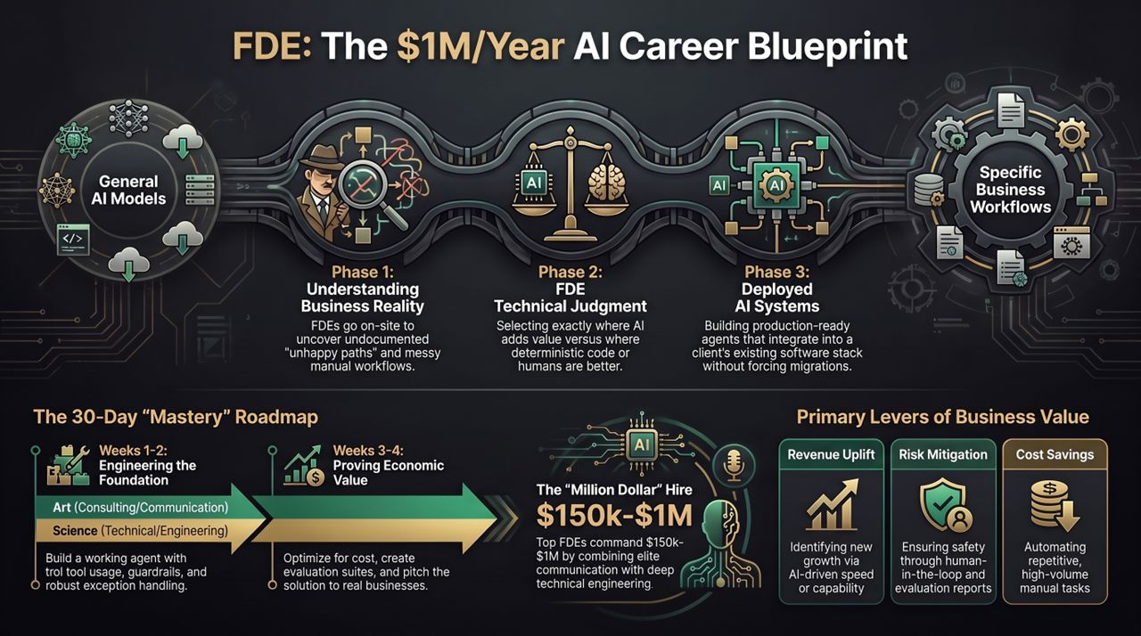
Notes:
Final Synthesis: This closing visual pulls together the full end-to-end Forward Deployed Engineer blueprint.
Left Side (The Input): General AI models are downloadable commodities.
Right Side (The Output): Enterprises require deeply integrated, specific operational systems.
Middle (The FDE Bridge): The FDE combines technical depth with strong consulting and communication abilities to translate raw model intelligence into production value.
Call to Action: Whether you are looking to pivot your technical career or scale AI deployments inside your company, mastering this 30-day OS gives you a clear path to becoming a high-value Forward Deployed Engineer.
https://www.youtube.com/watch?v=zXysLUTLjw4

